Slide 1
Wearable's

Slide 2
What Is Wearable Technology?
‘Wearable Devices’ or ‘body-borne computers’ that can be worn by user - but are
intended to interact with the wearer without punching keys or other manipulation
- always on, always working
- performs calculations and processes information
The Wearable technology consists of two parts
sensors, glasses, watches
and even foot wear
Information aggregator
& analyzer

Slide 3
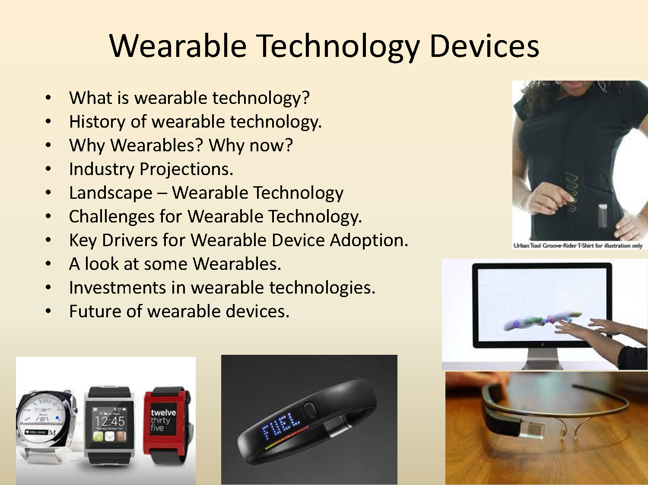

Slide 4
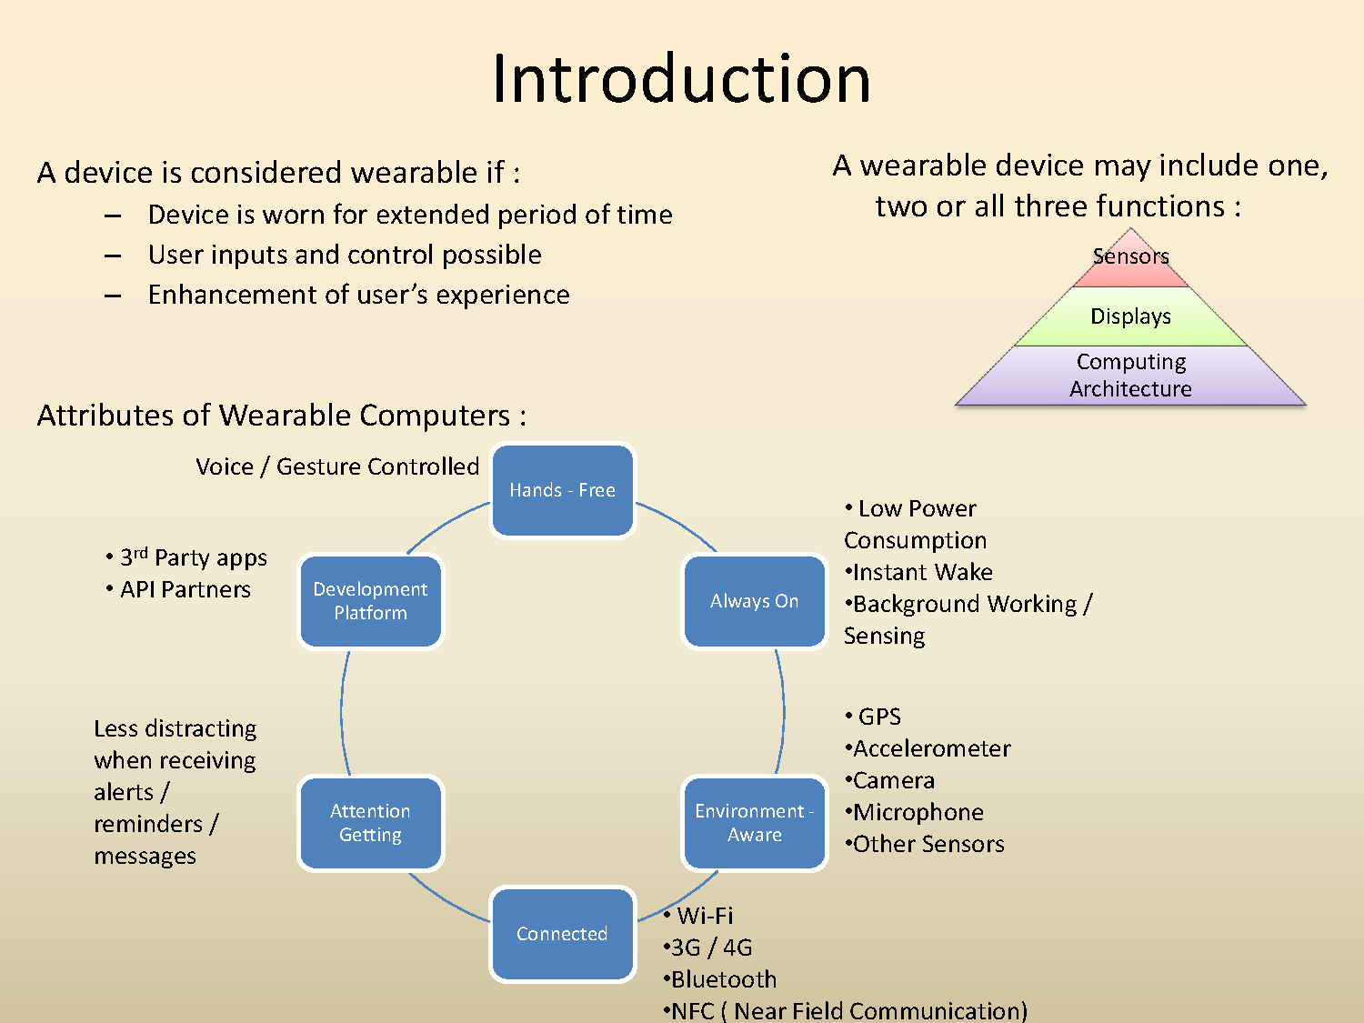

Slide 5
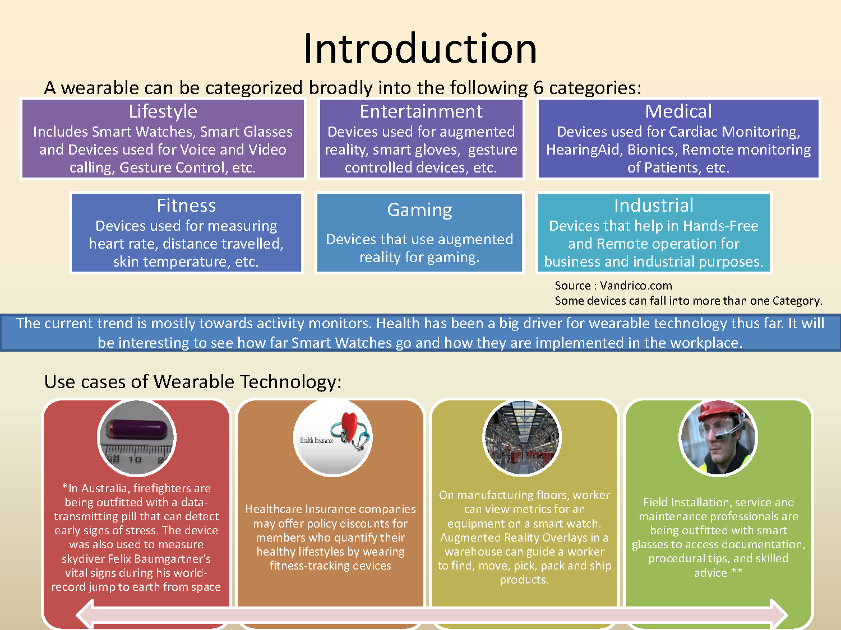

Slide 6
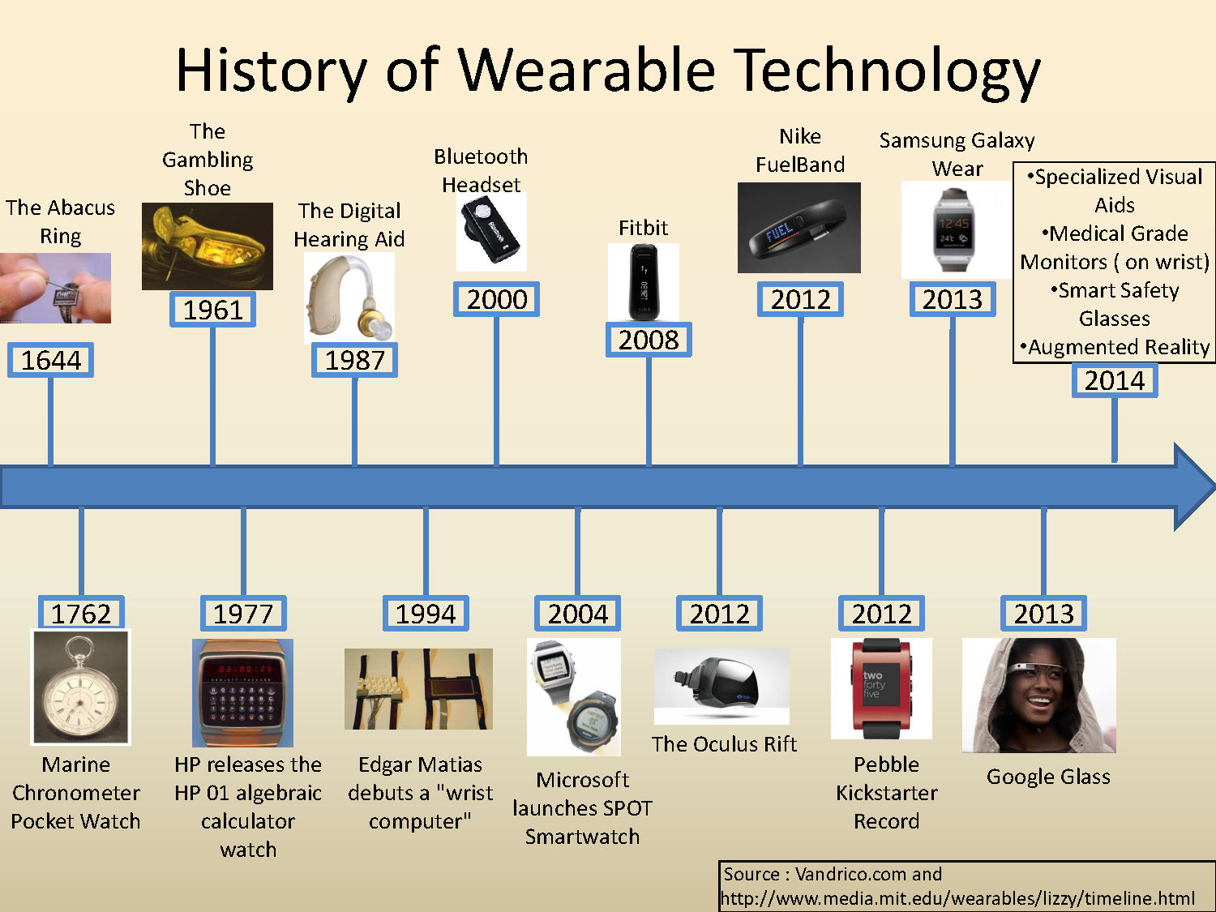

Slide 7
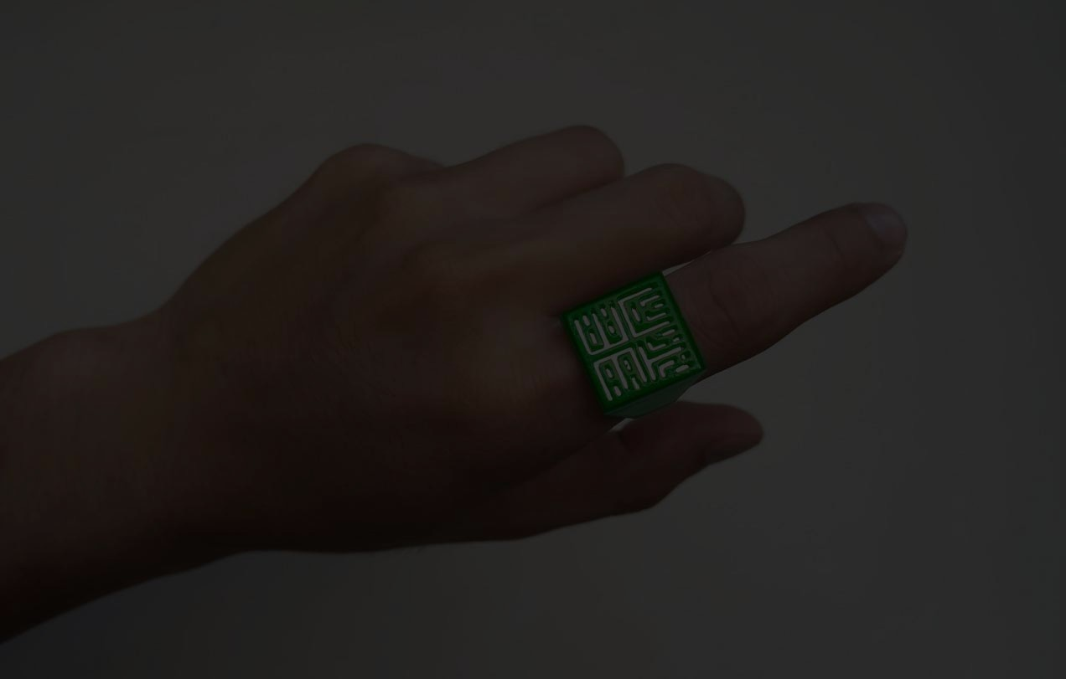

Forces Driving the Growth of Wearable Technology
Internet of things, big data and SDN Consumerisation of enterprise IT Multiple devices ownership, Improvement of camera technologies Cloud storage services – expected to exceed 2 billion by 2014 Reduced IT cost with Cloud Computing
Getting 100 times smaller each decade Capabilities and feature convergence Easy portability By 2020, batteries are expected to be 2.2x more powerful
Implicit location information, Internet traffic information Device based location service (GPS) iOS, Android, Blackberry OS, Windows Mobile, Symbian S60
Cloud Storage
Faster, smaller,
Cheaper hardware
Location Data

Slide 8
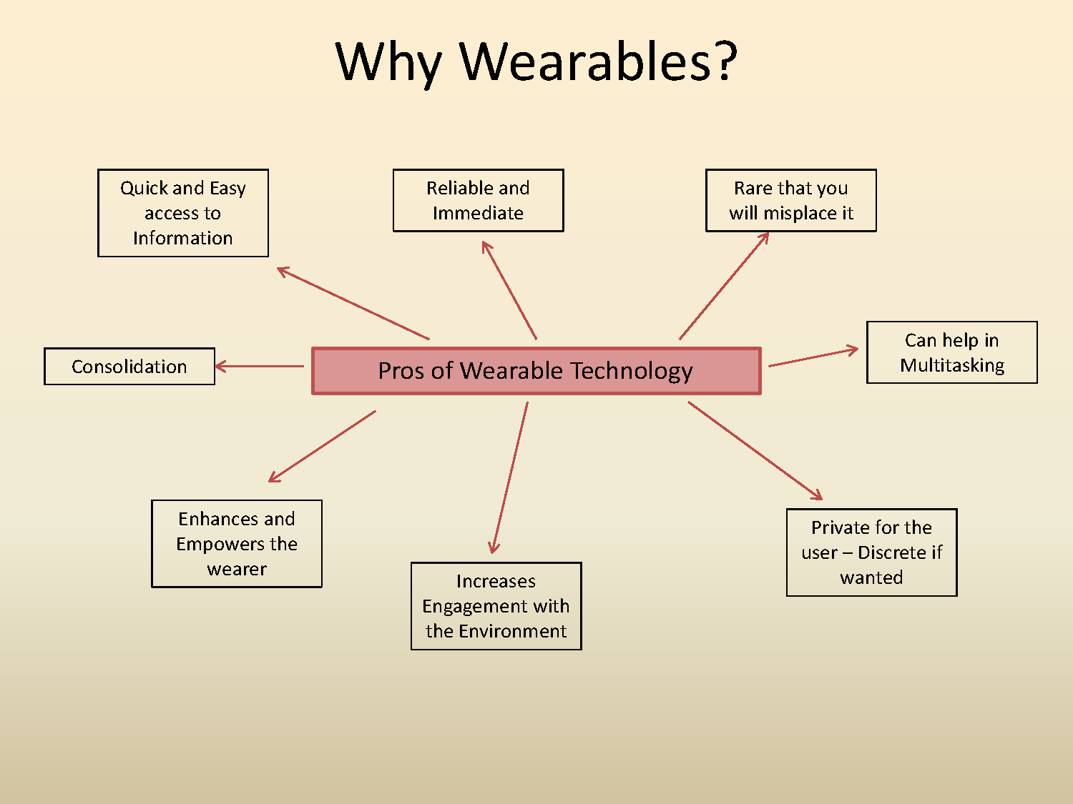

Slide 9
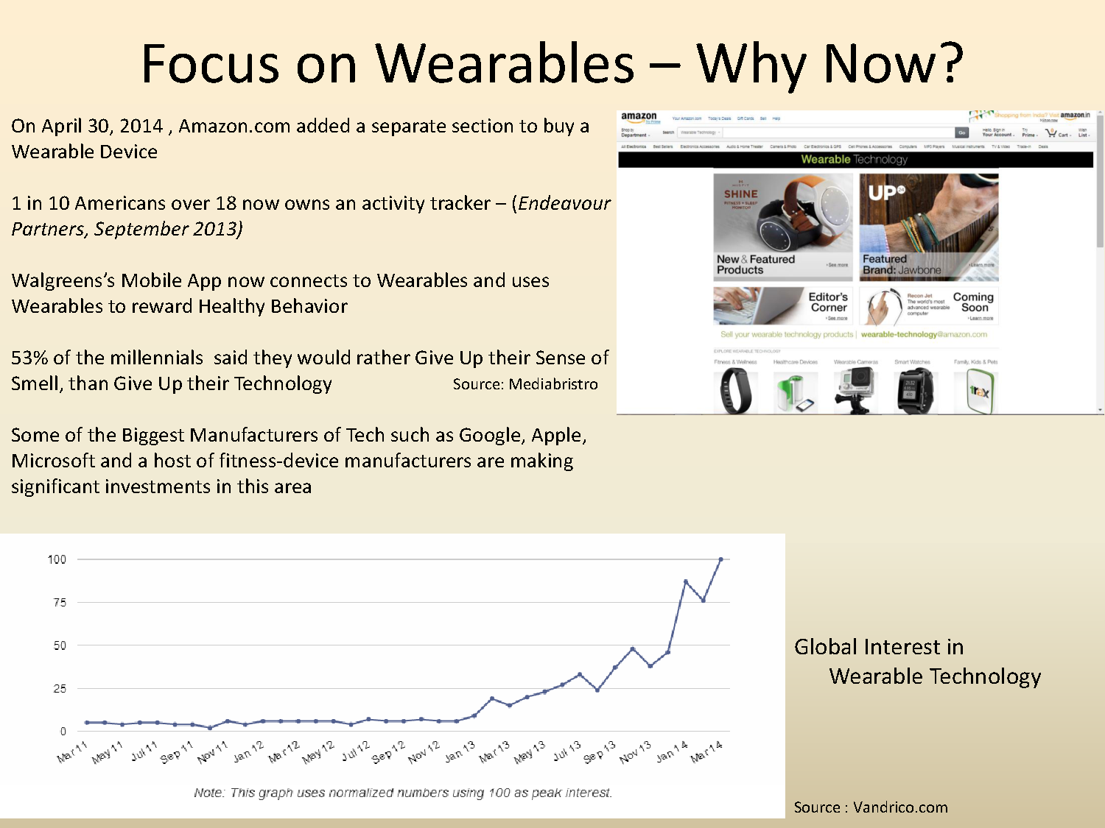

Slide 10
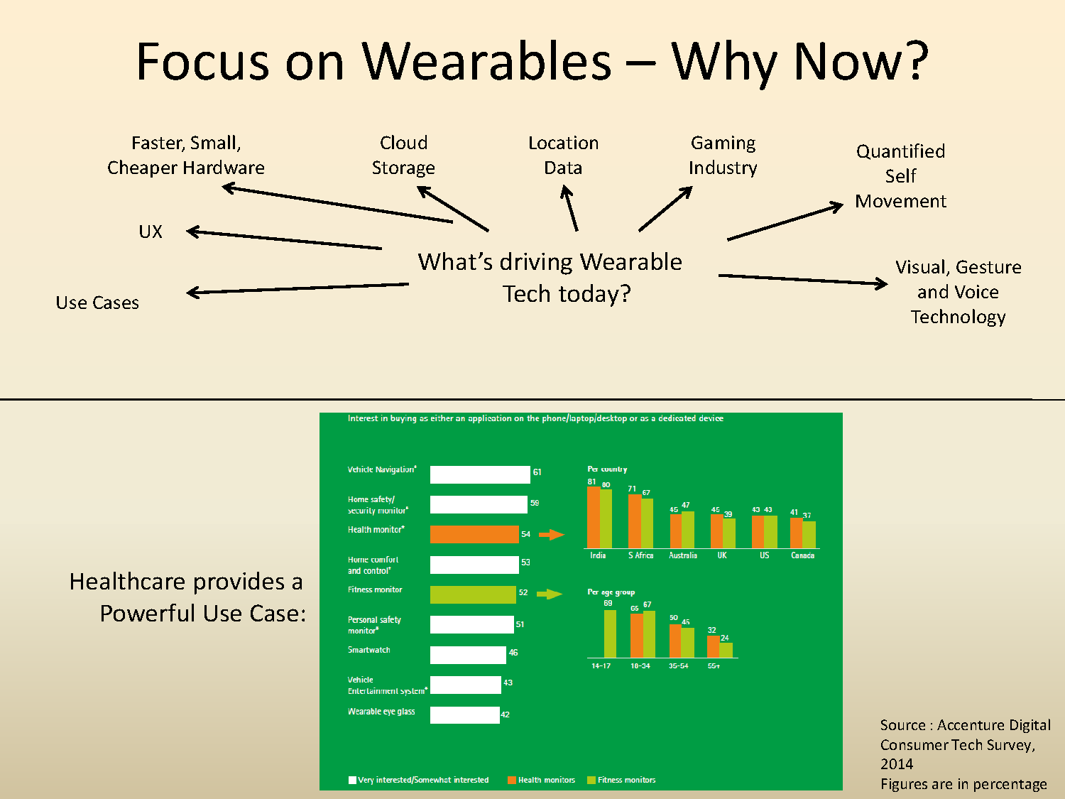

Slide 11
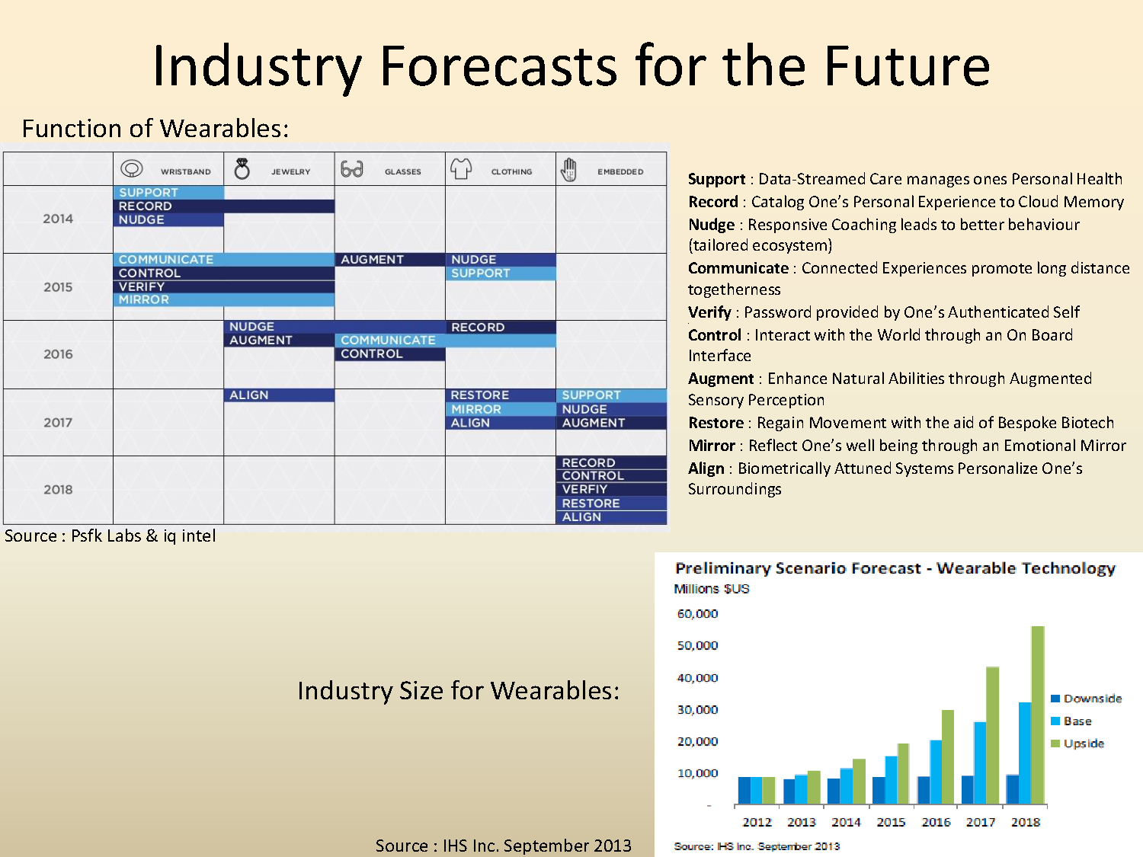

Slide 12
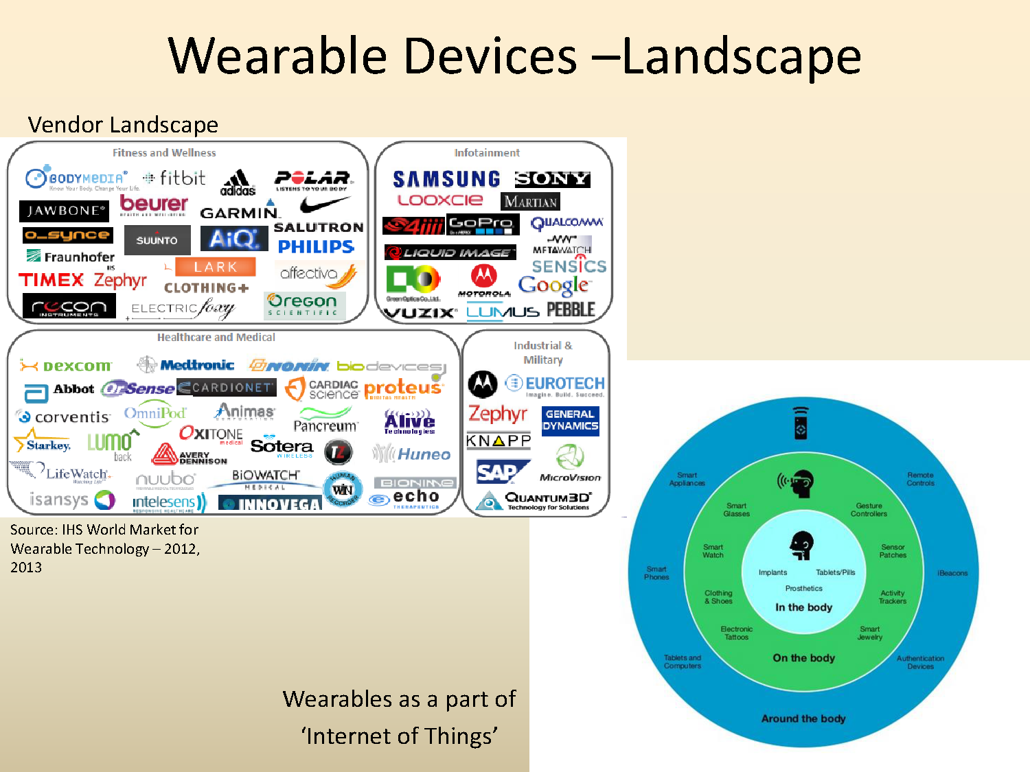

Slide 13
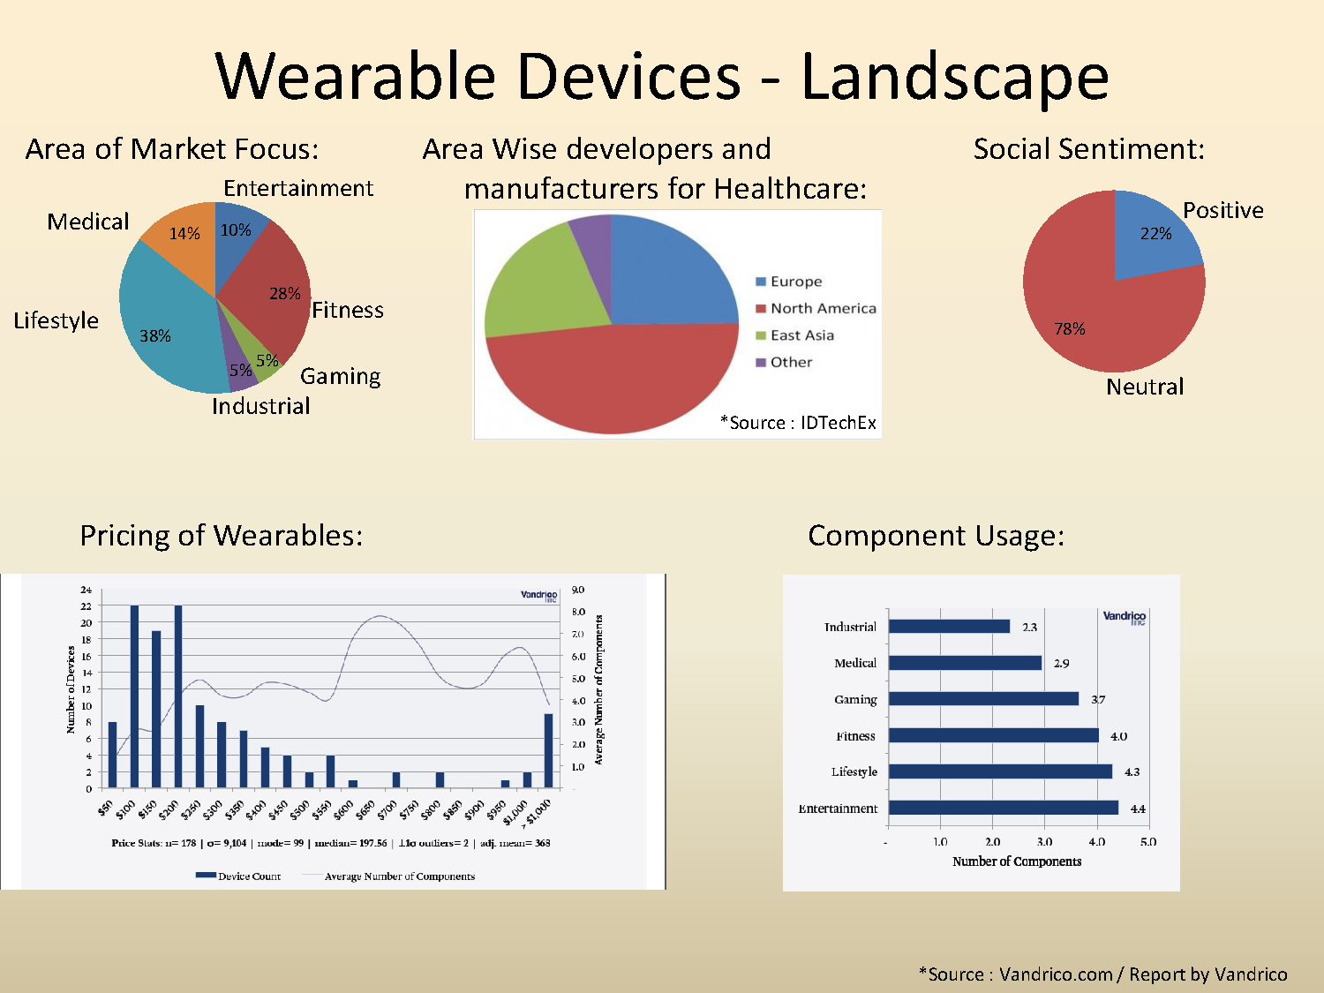

Slide 14
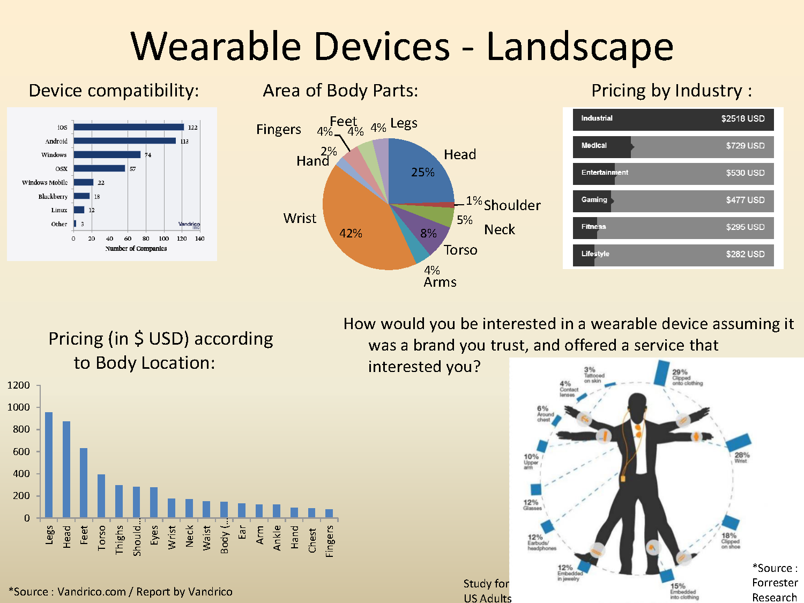

Slide 15
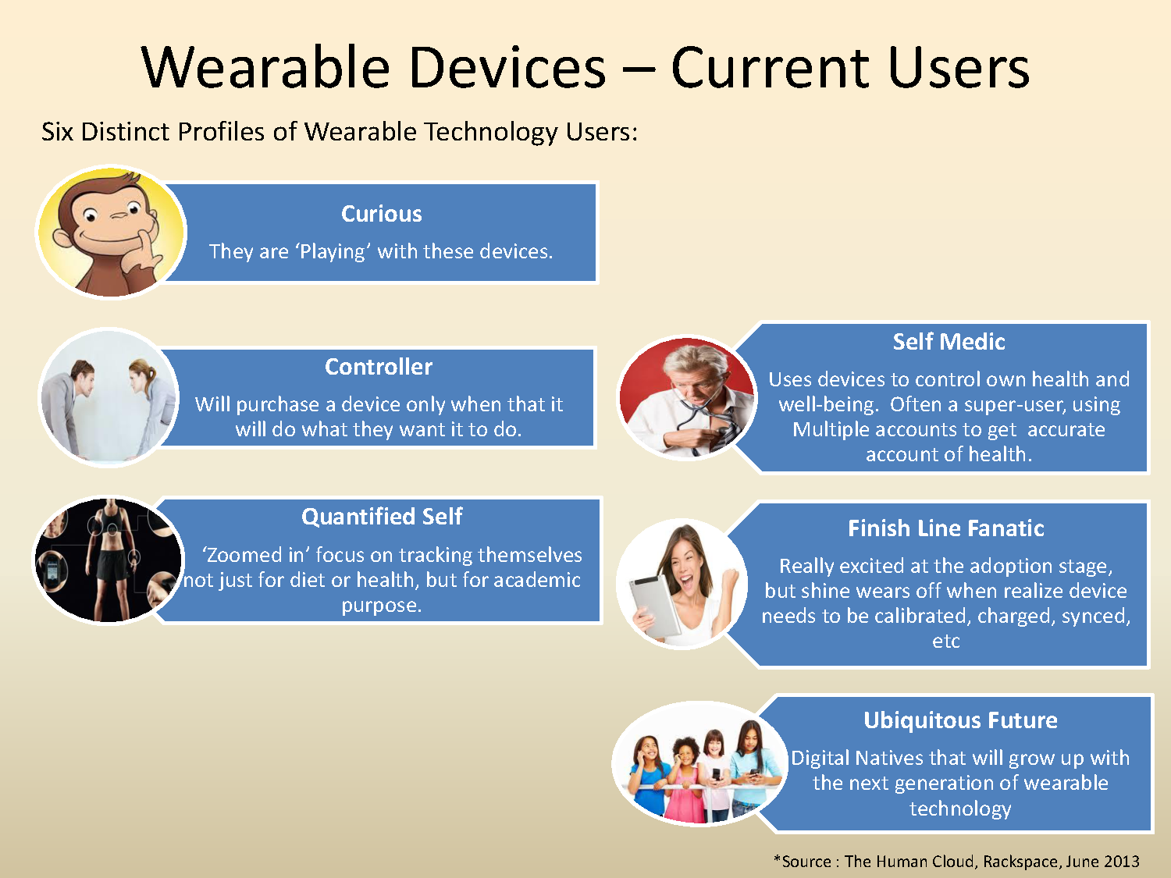

Slide 16
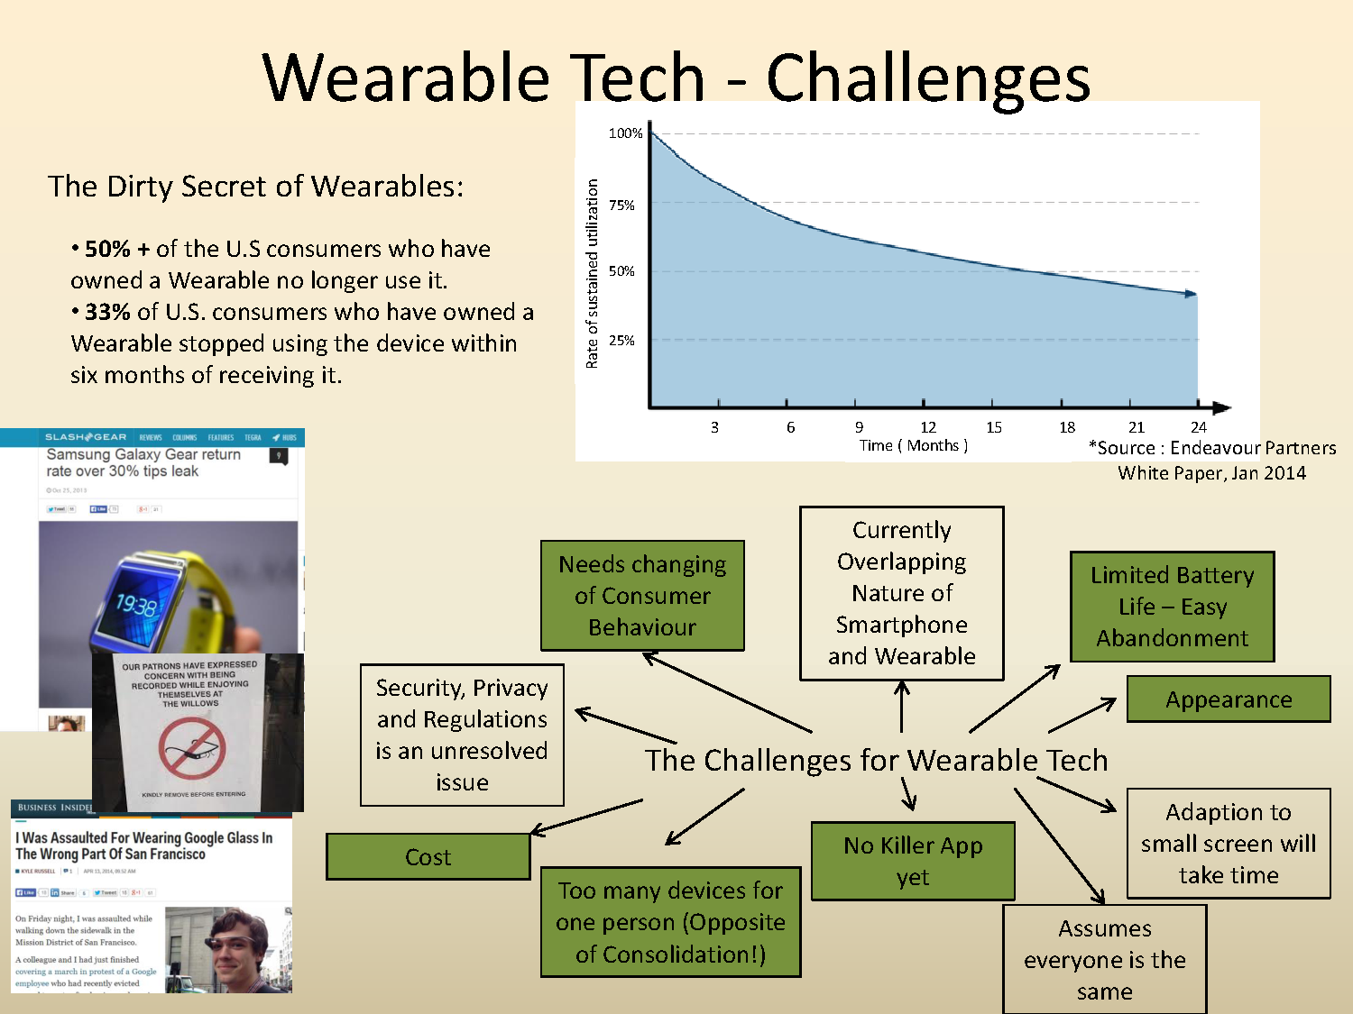

Slide 17
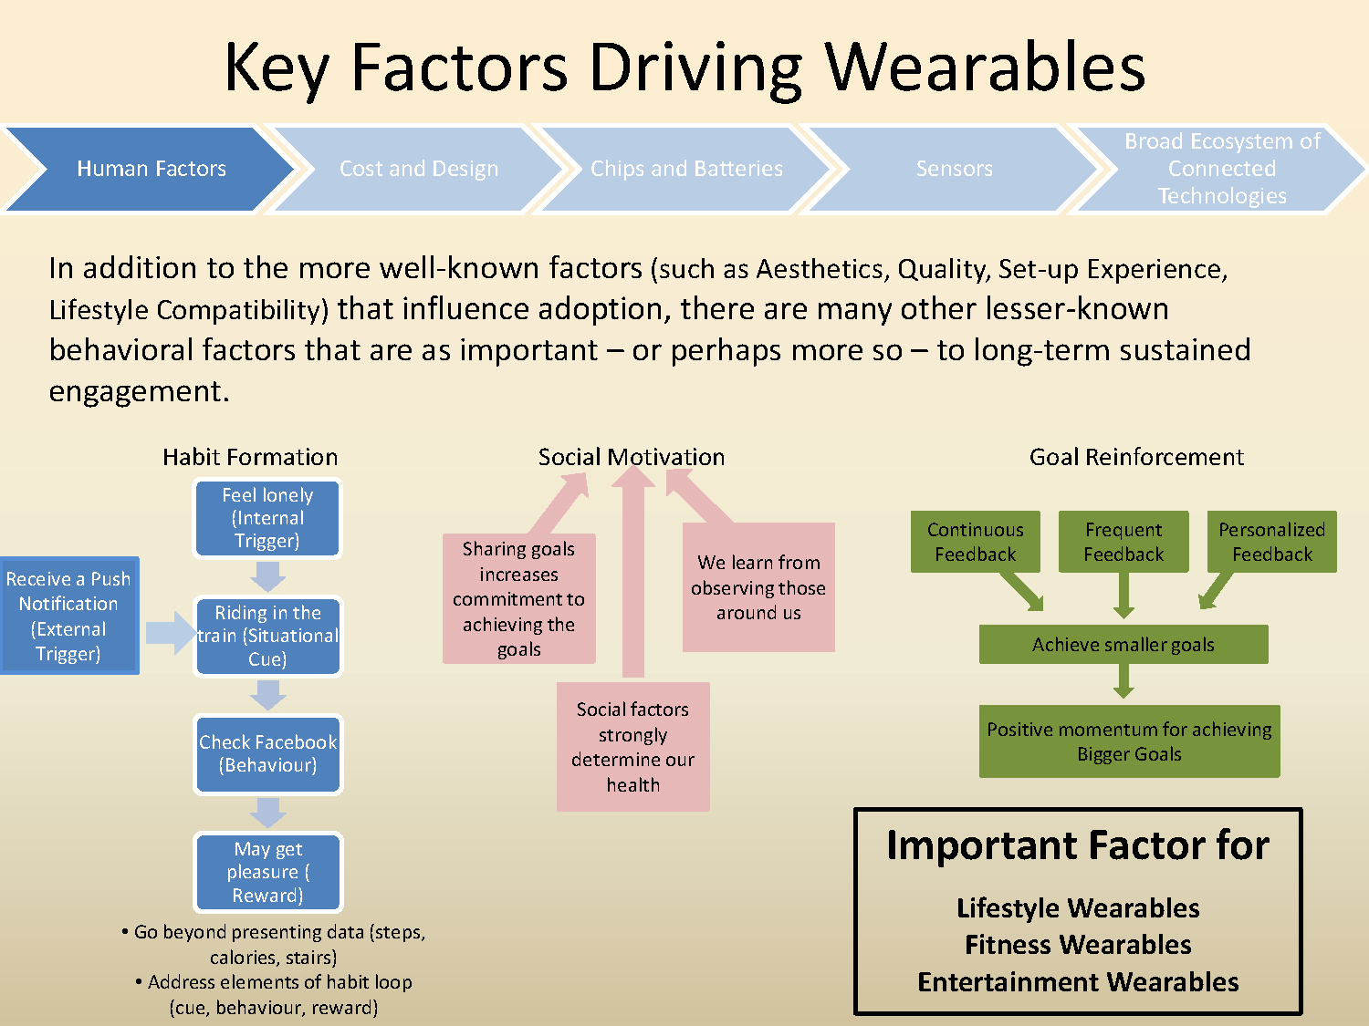

Slide 18
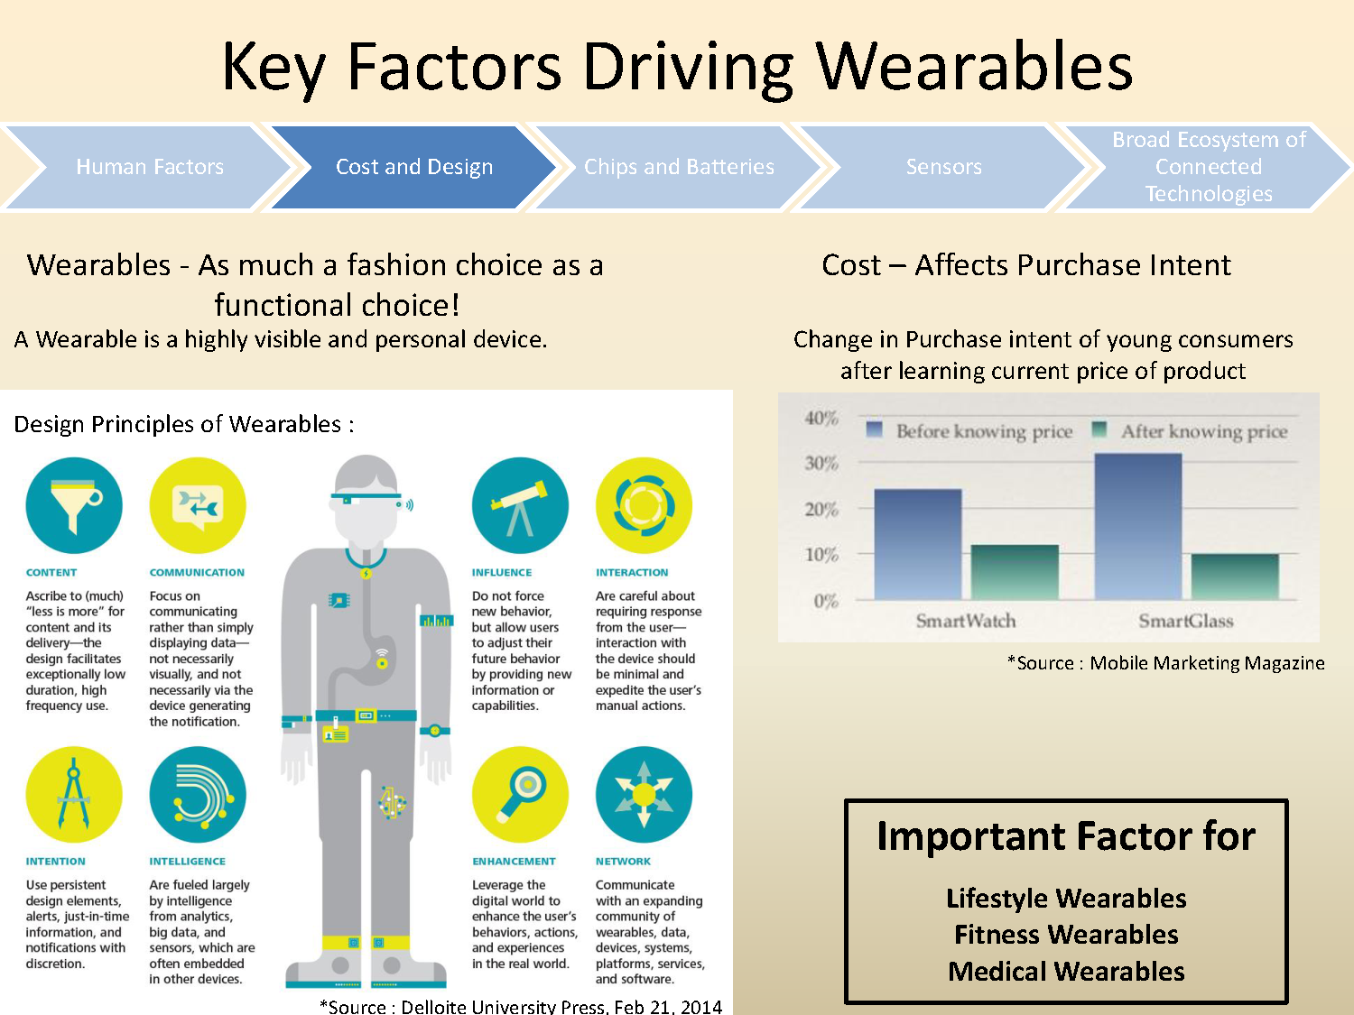

Slide 19
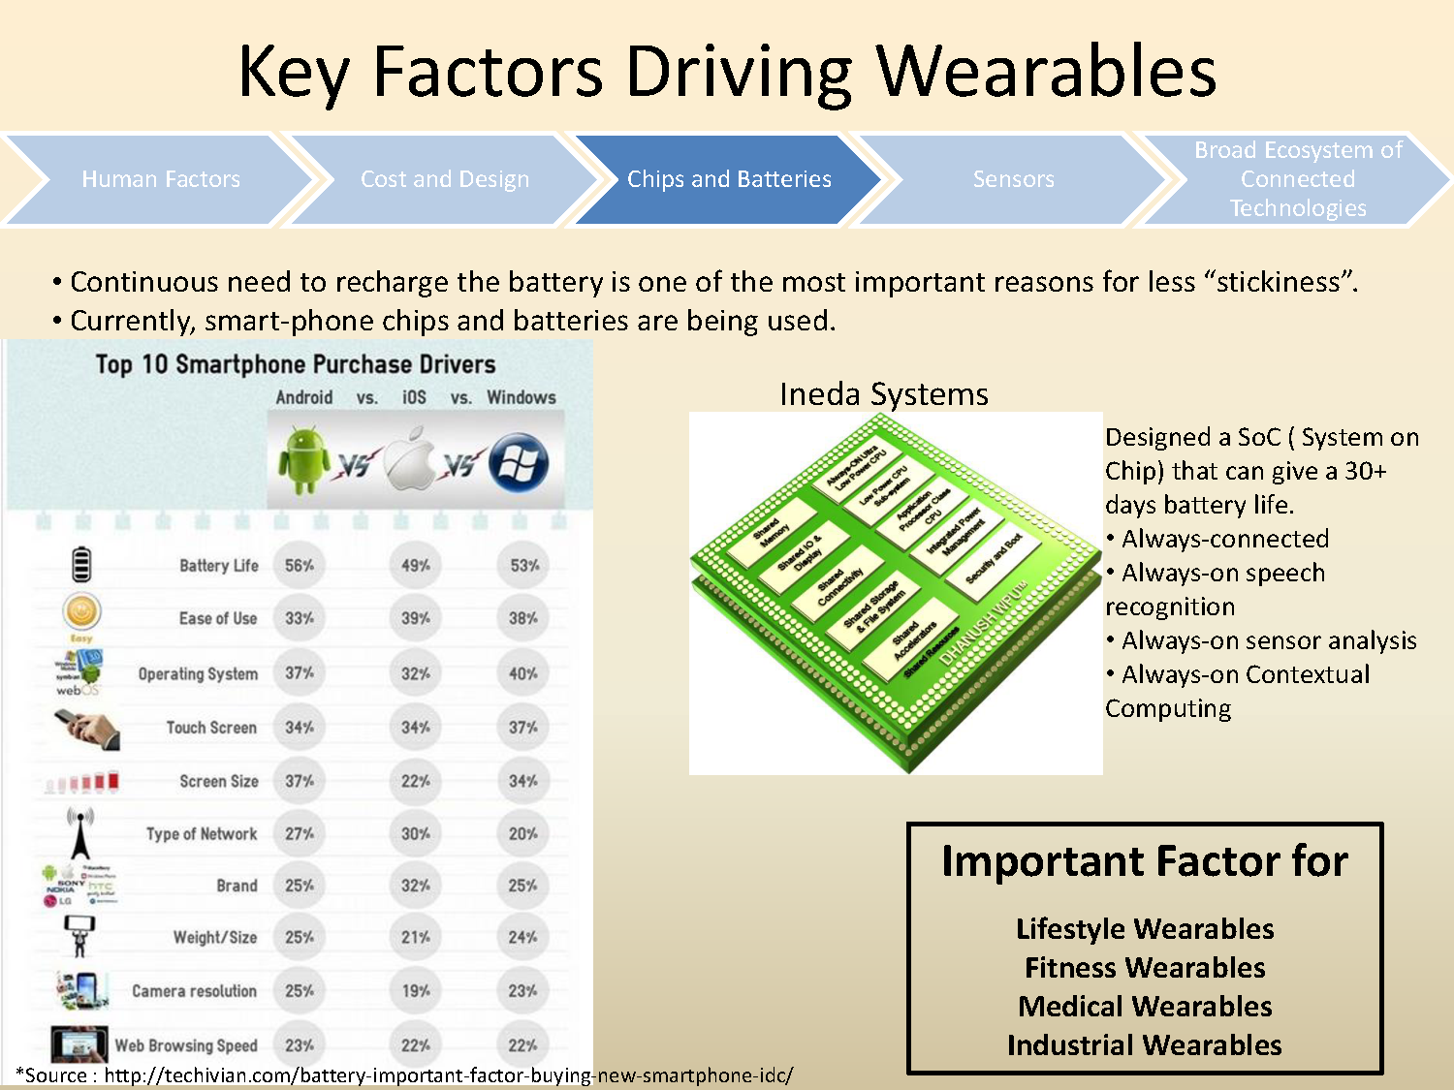

Slide 20
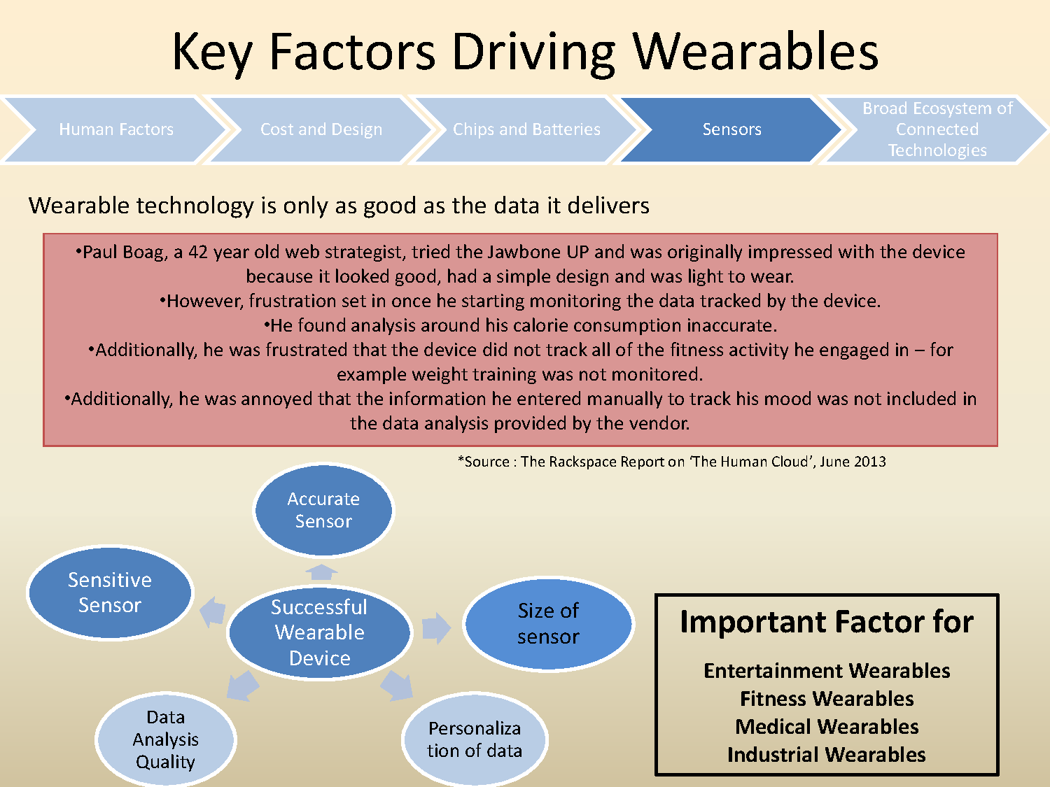

Slide 21
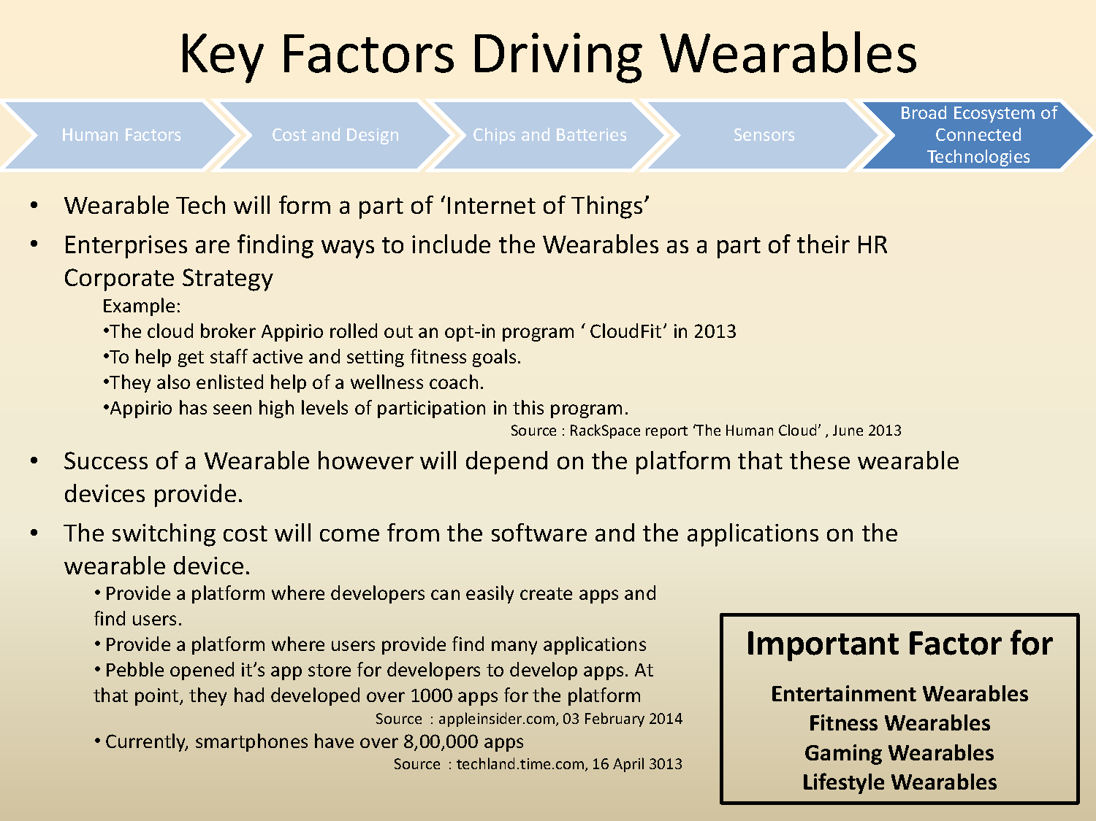

Slide 22
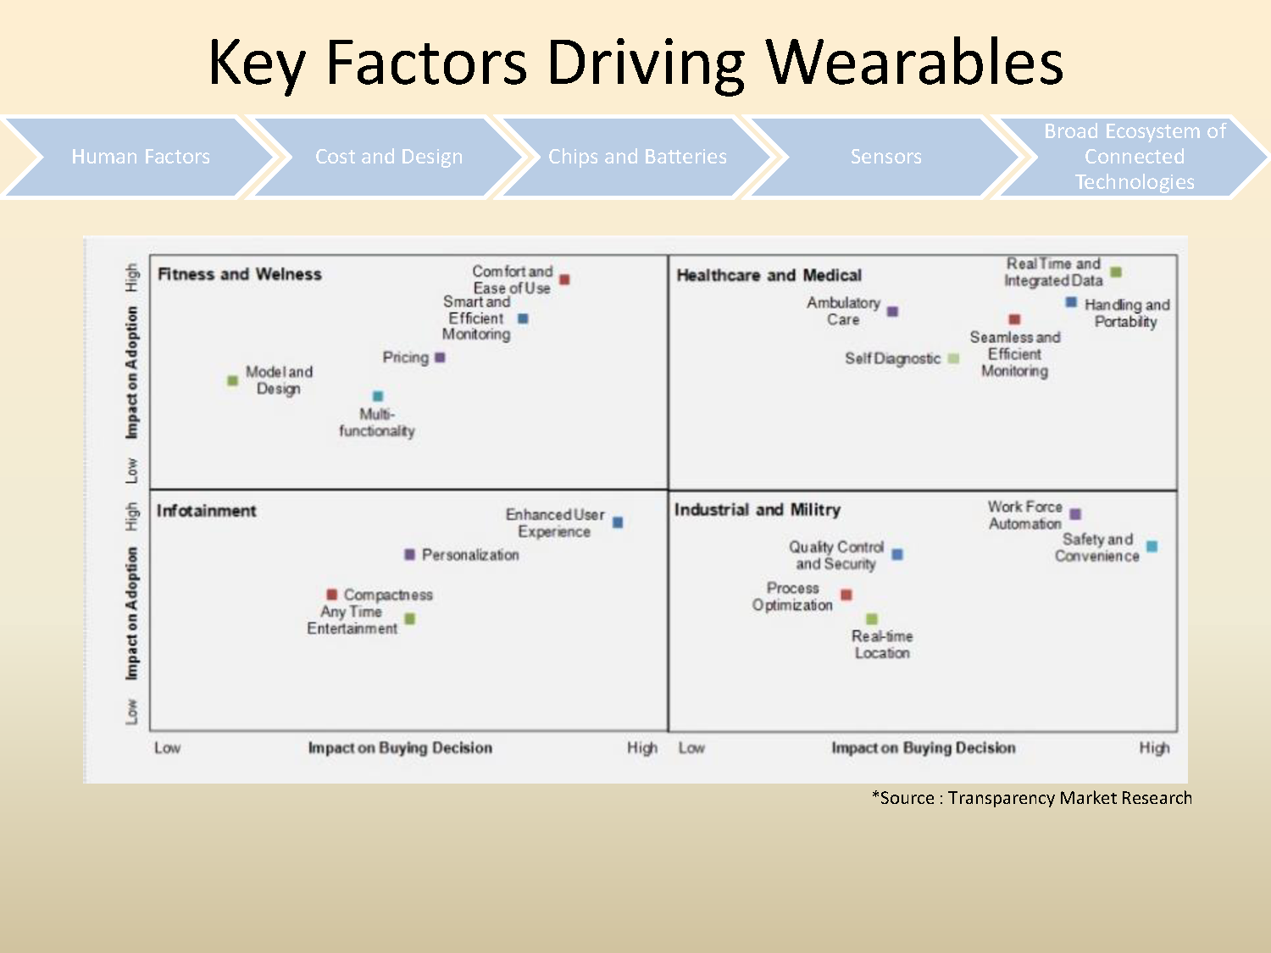

Slide 23
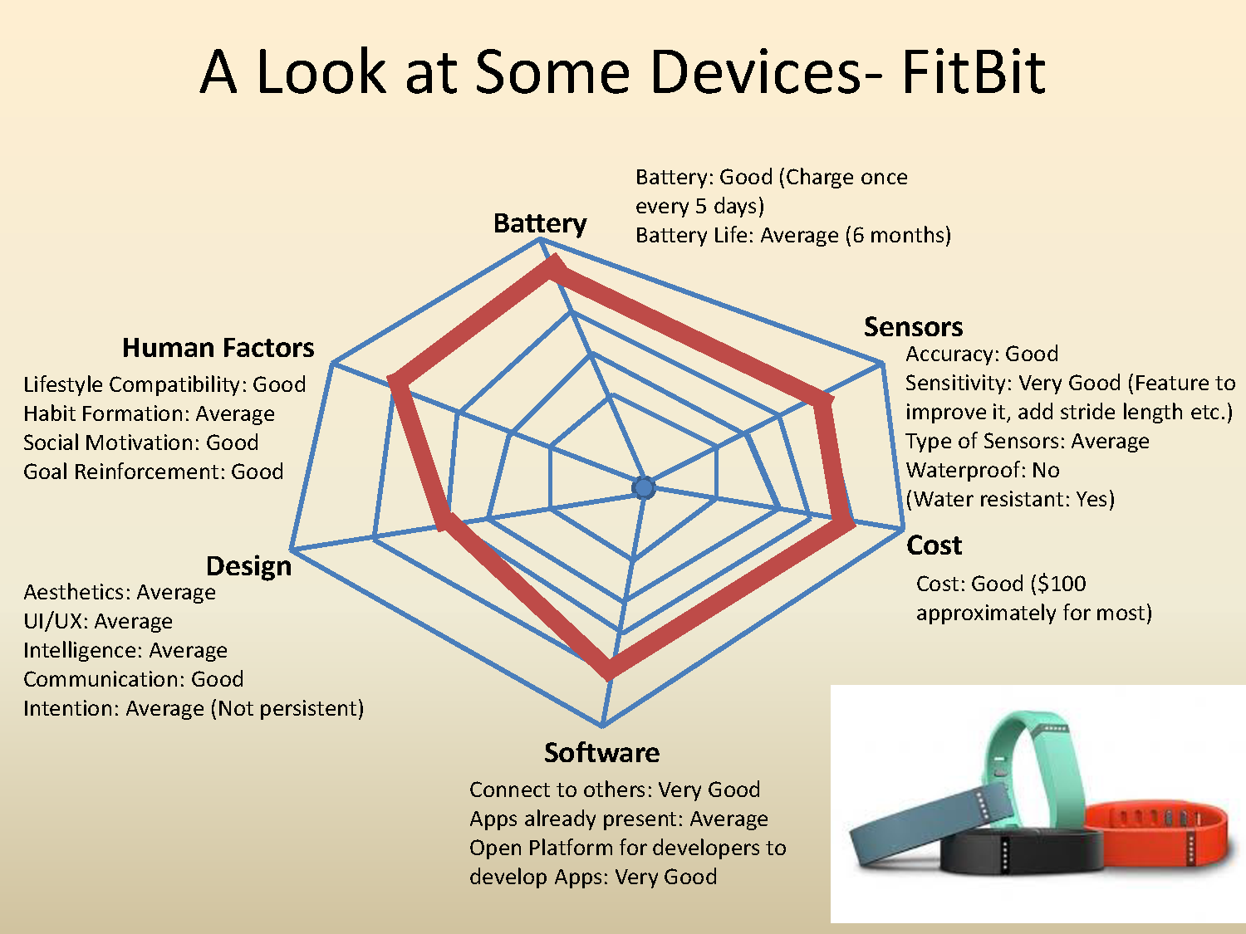

Slide 24
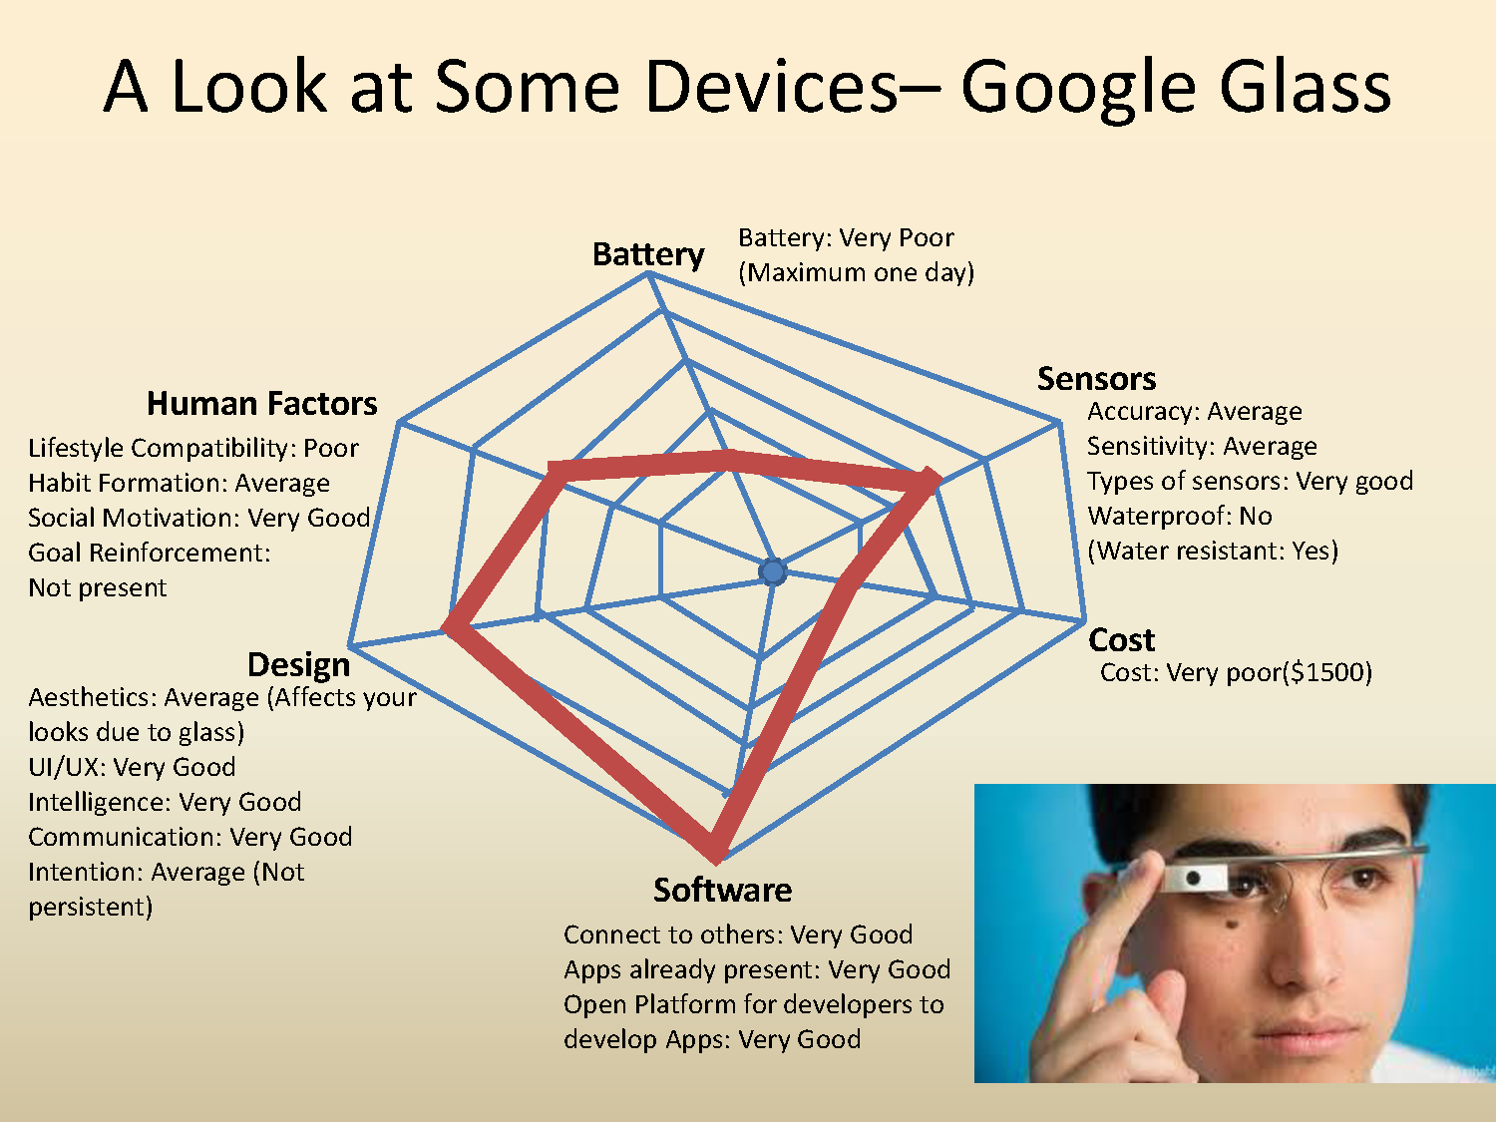

Slide 25
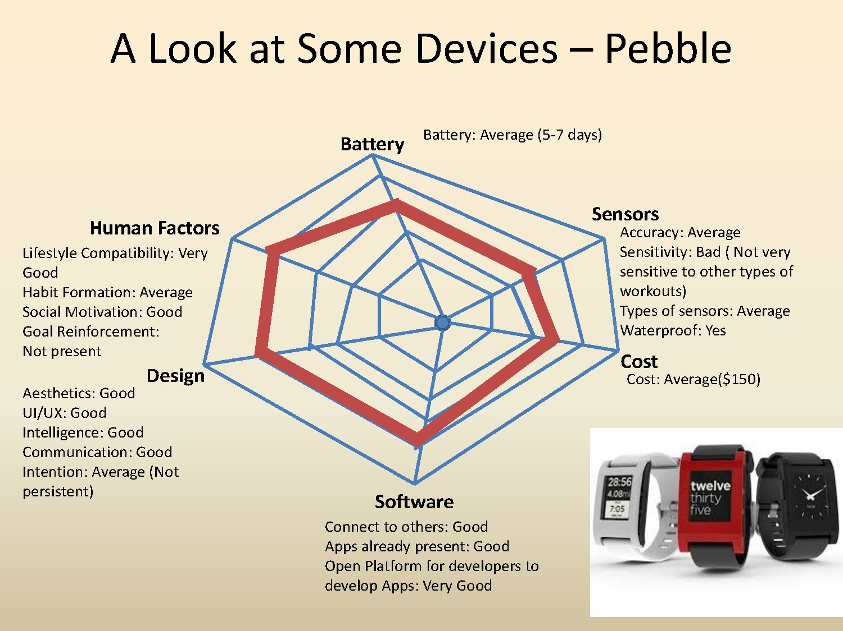

Slide 26
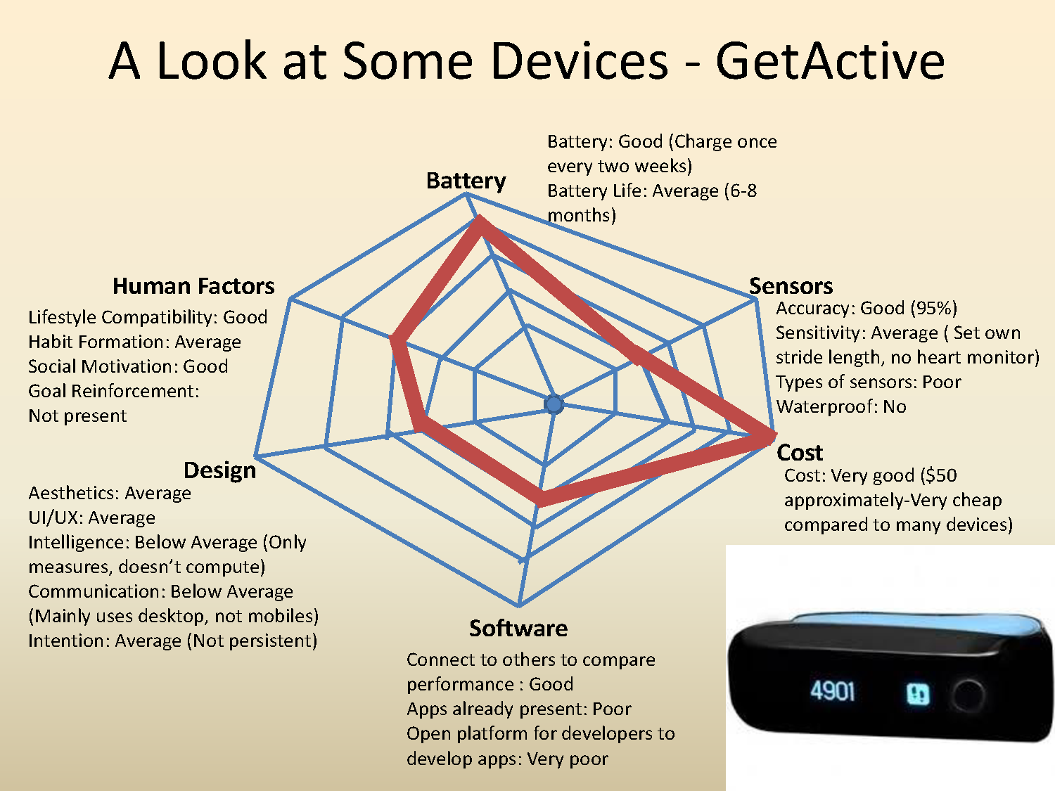

Slide 27
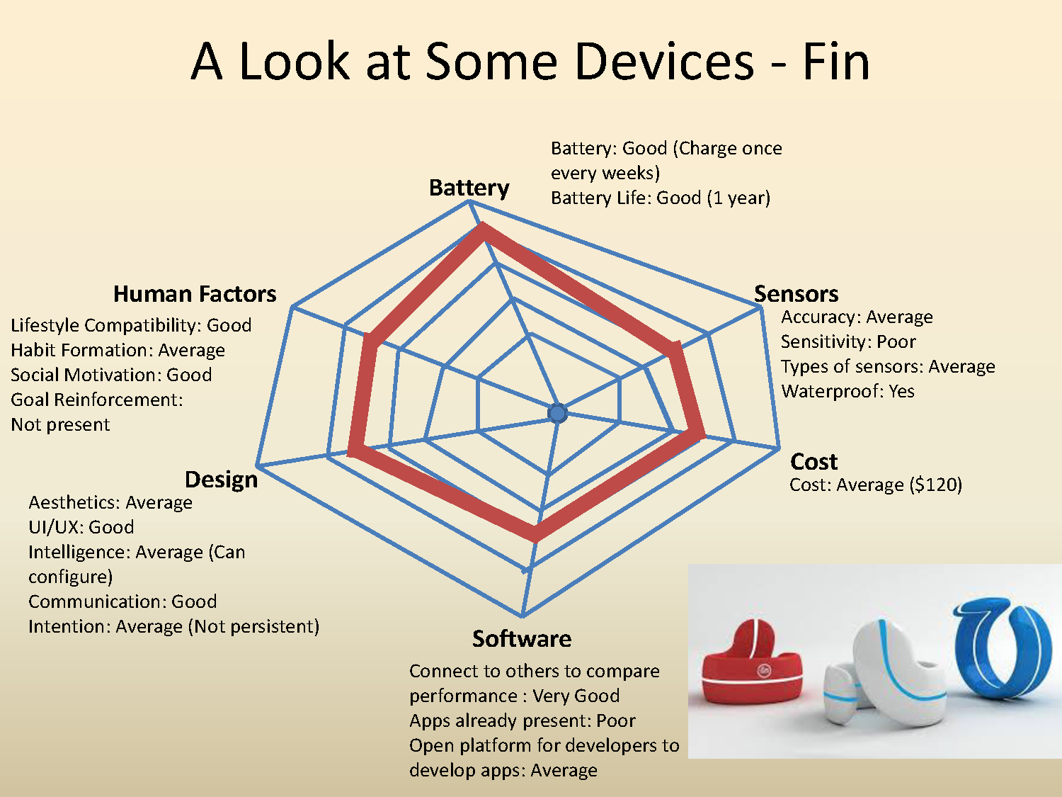

Slide 28
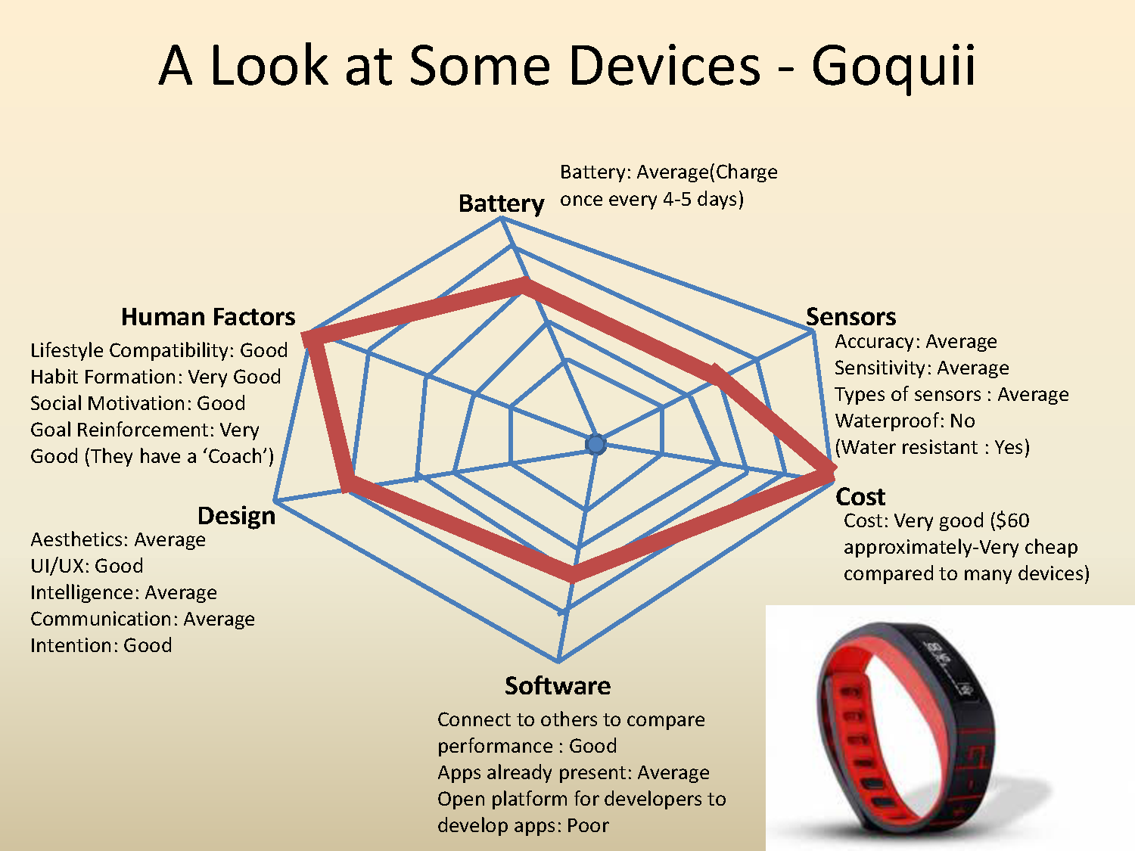

Slide 29
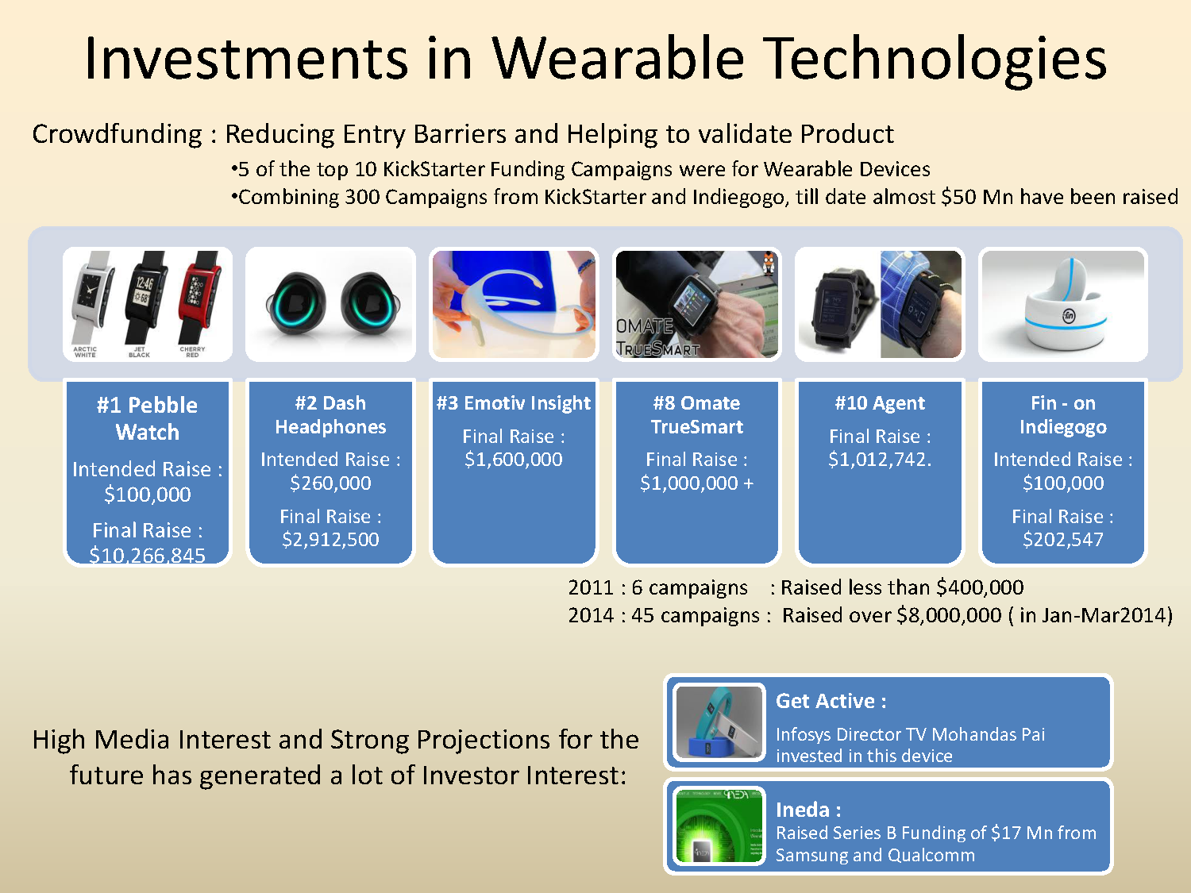

Slide 30
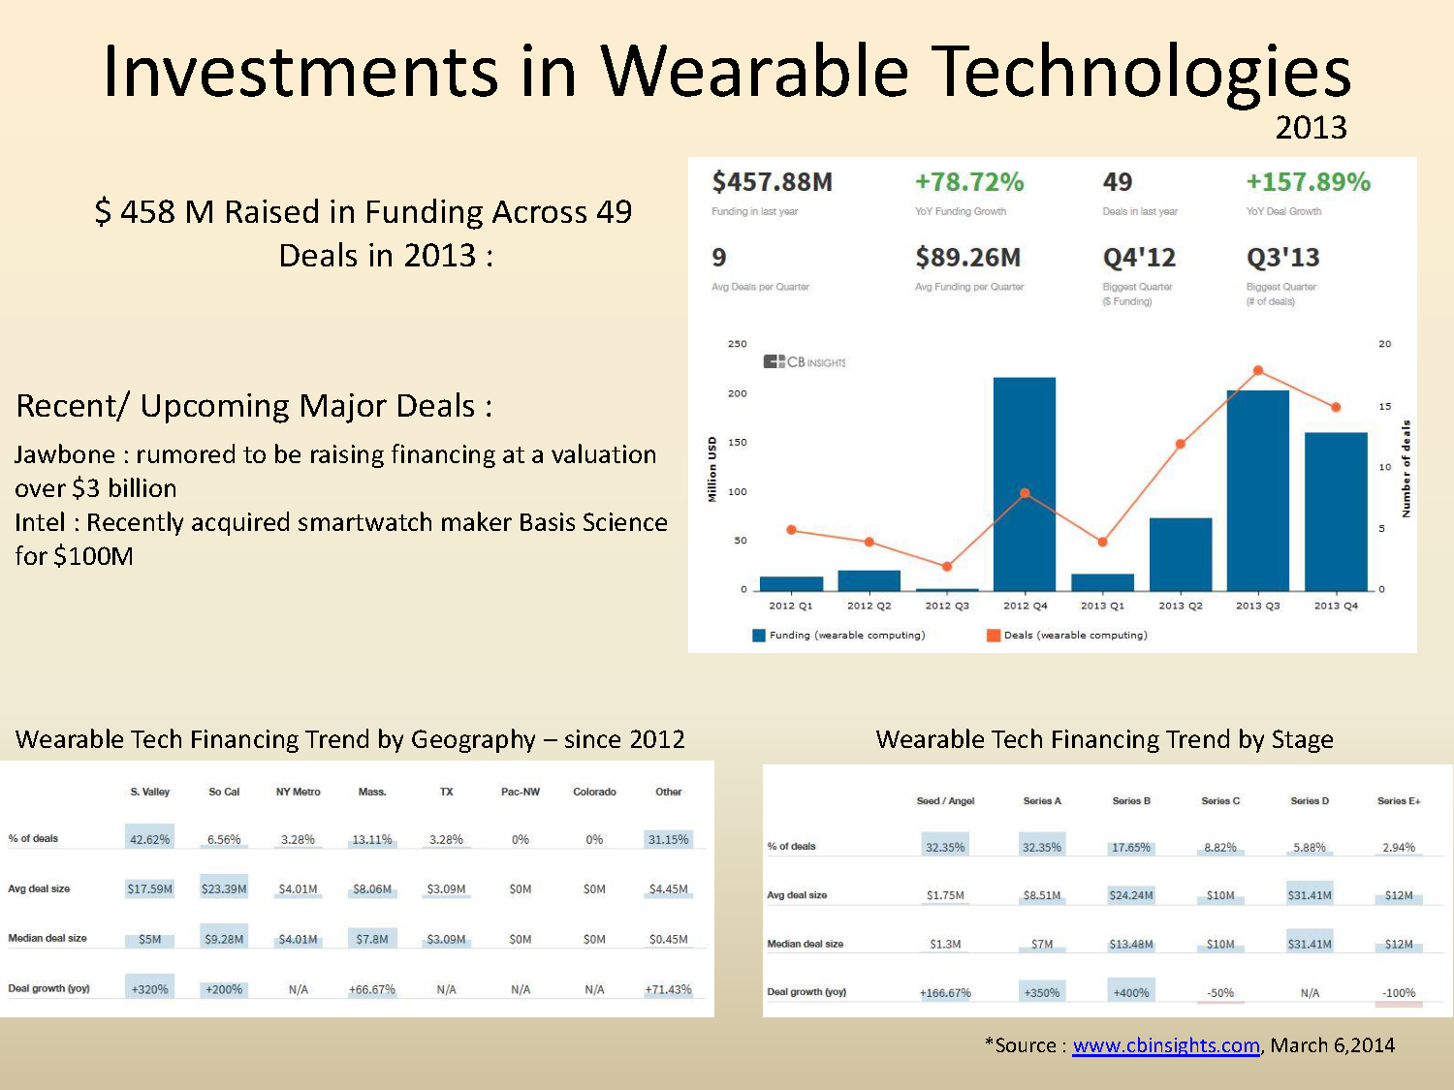

Slide 31
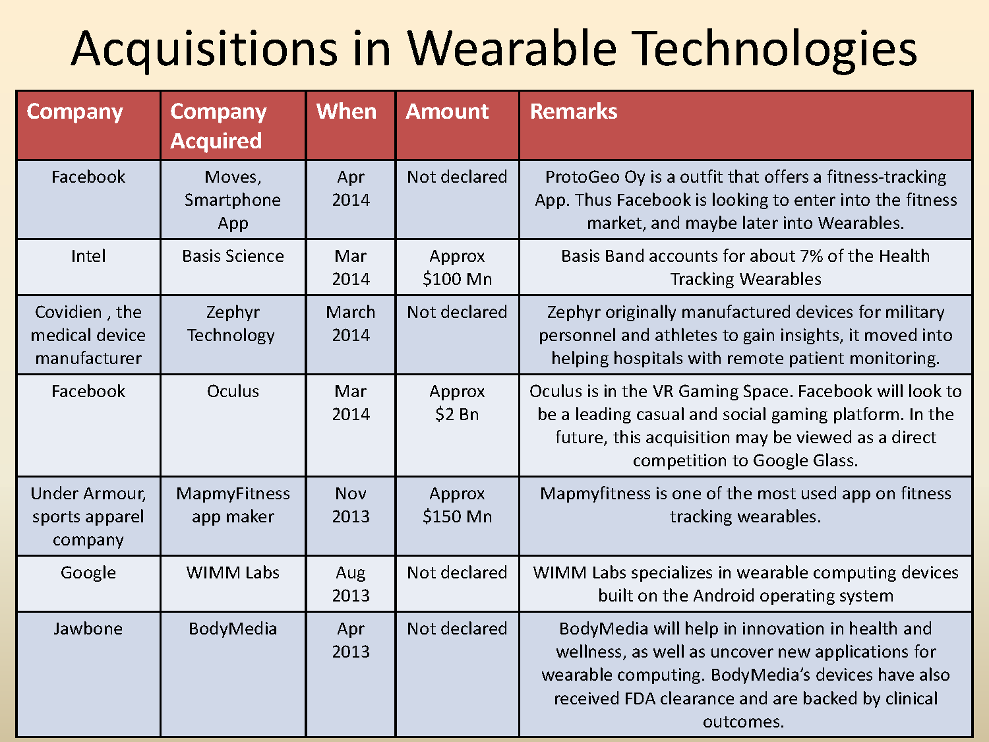

Slide 32
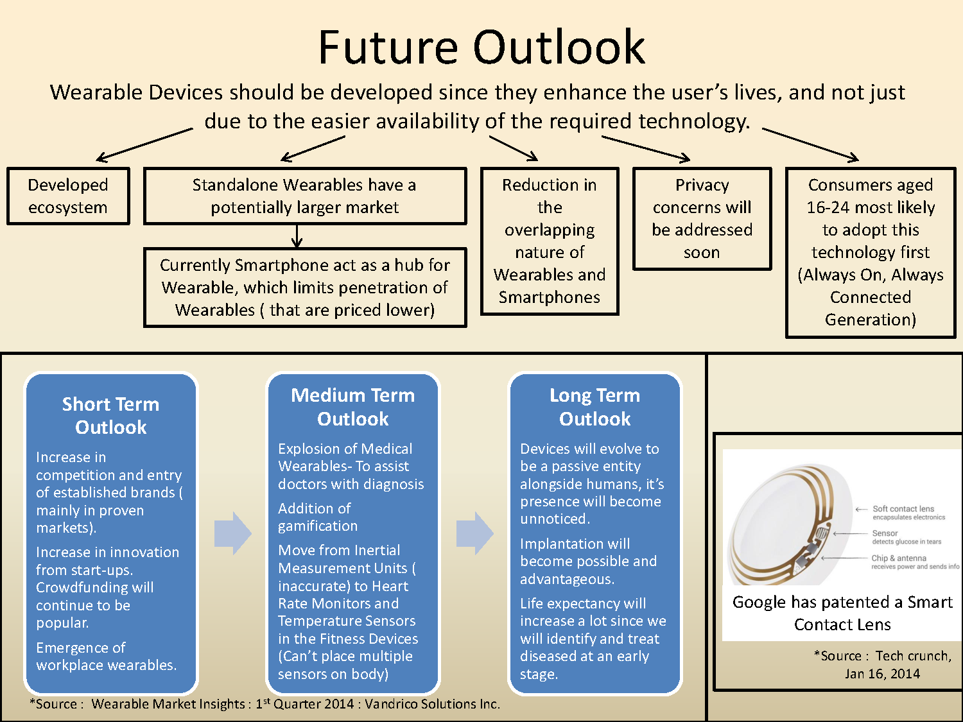

Slide 33
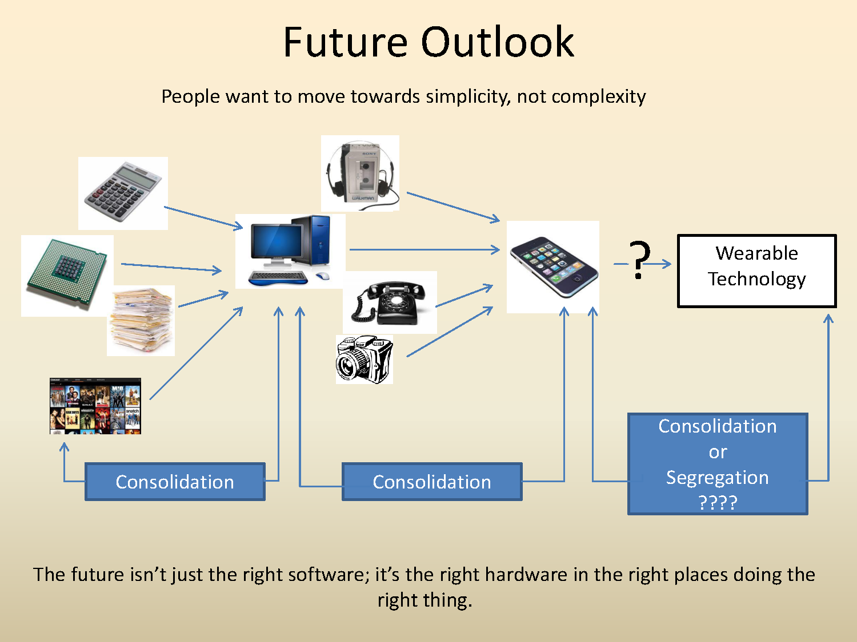

Slide 34


